Slide 1
Customer Churn Prediction Model

Slide 2
Problem Statement
We aim to accomplish the following for this project:
Identify and visualize which factors contribute to customer churn.
Build a prediction model that will perform the following:
Classify if a customer is going to churn or not.

Slide 3
Introduction
With increased competition in the banking business, banks must implement client retention strategies while attempting to improve their market share by gaining new customers.
It has been demonstrated that increasing the retention rate by up to 5% may improve a bank's profit by up to 85%.
Furthermore, recruiting new consumers is more expensive for any organization than maintaining old ones, who are more likely to make profit.
As a result, banks should preserve their competitive edge by using machine learning algorithms to forecast client turnover.

Slide 4
Technology Used
Pandas- pandas is a software library written for the Python programming language for data manipulation and analysis.
Numpy- is a library for the Python programming language, adding support for large, multi-dimensional arrays and matrices.
Matplotlib- is a plotting library for the Python programming language and its numerical mathematics extension NumPy.
Seaborn- is a library in Python predominantly used for making statistical graphics and data visualization.
Scikitlearn- “It features various algorithms like support vector machine, random forests, and k-neighbours, and it also supports Python numerical and scientific libraries like NumPy and SciPy”

Slide 5
Plan of Action
We downloaded the data-set of bank customers from “Kaggle.com”, it’s raw data we pre-process on the data to make it in a proper and useful format.
We come to know that it has 10000 no of rows and 14 no of columns.
Then we import all libraries in Jupyter notebook(text-editor),
(import NumPy as np)
(import pandas as pd)
(import matplotlib. pylot as plt)
(import seaborn as sns).
We visualize data using matplotlib and seaborn.
We then use a train split-test data set into 30% and 70%.
We then use various algorithms to check model accuracy.
After compilation of the model and training it, we try to deploy it.
Ensuring a connection to the frontend with flask and HTML we try to make it user friendly and use with ease
New technologies using HTML, CSS, Flask, GitHub, Heroku.

Slide 6
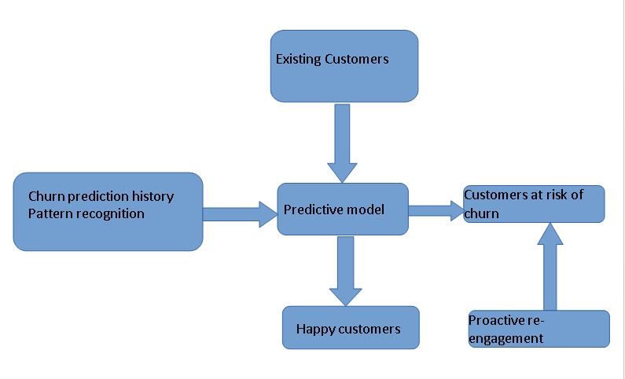
ER Diagram

Slide 7
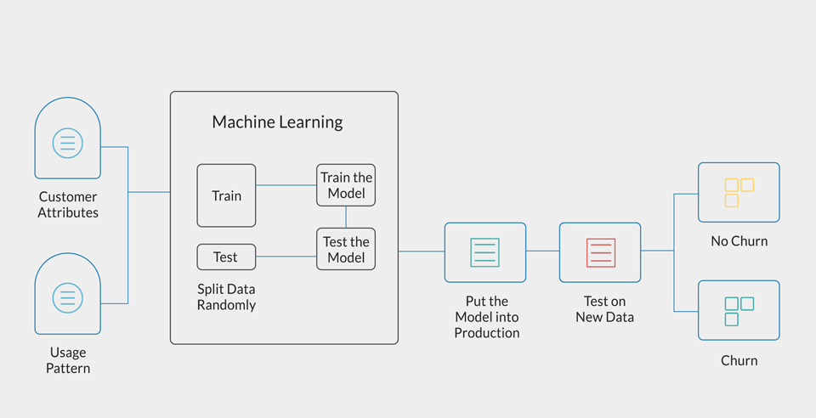
Activity Diagram

Slide 8
Advantage
It’s a fact acquiring new customers is a costly affair but losing the existing customers will cost even more for the business or the organization. As existing paying customers are usually returning customers who if happy will purchase repeatedly from your brand.
The competition in any market is on a rise and this encourages organizations to focus not only on new business but also on retaining existing customers.
The most essential step towards predicting customer churn is to start awarding existing customers for constant purchases and support.
An entire customer journey leads to customer churn and not just a few incidents. Due to the priority of avoiding customer churn, organization’s should start offering incentives on purchases of these soon-to-churn customers.

Slide 9
Conclusion
Boosting has given the increased accuracy of 86.85 with low error, high sensitivity and speciﬁcity. Organizations periodically calculate customer churn in multiple aspects.
Churning can be the number of customers lost, ratio or percentage of customers lost compared with total customers in the bank.
Churn can be calculated on a quarter or annual basis.
An accurate forecast can give insights on the future using which a strategy can be formulated.

Slide 10
Thank you!

